Slide 1
Streaming
The process of sending data from one system to another in such a way that allows the recievers to start process it before it's completely received

Slide 2
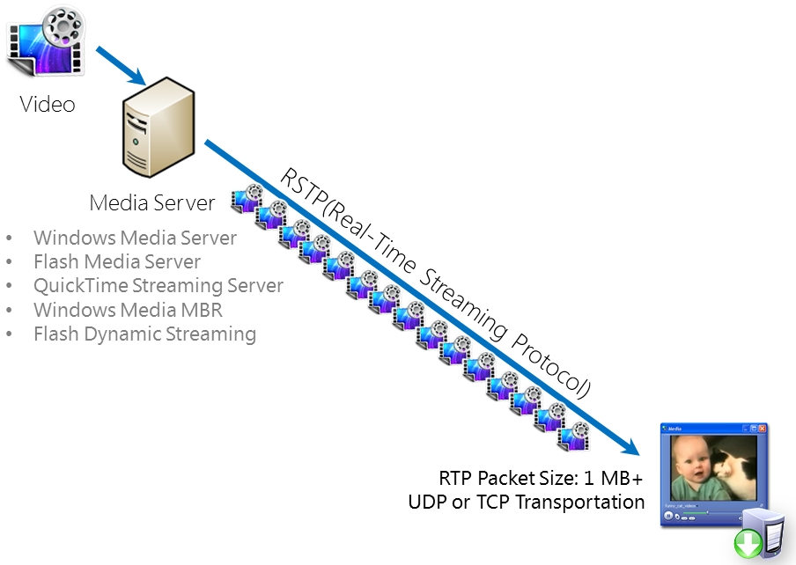

Slide 3
Progressive downloading

Slide 4
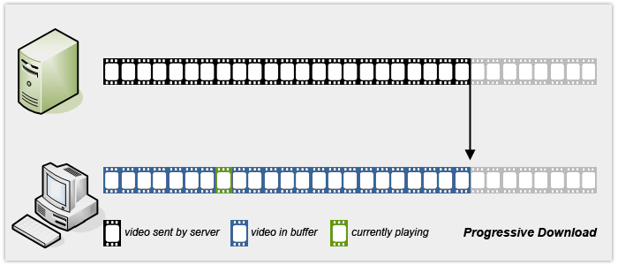

Slide 5
Adaptive Streaming

Slide 6
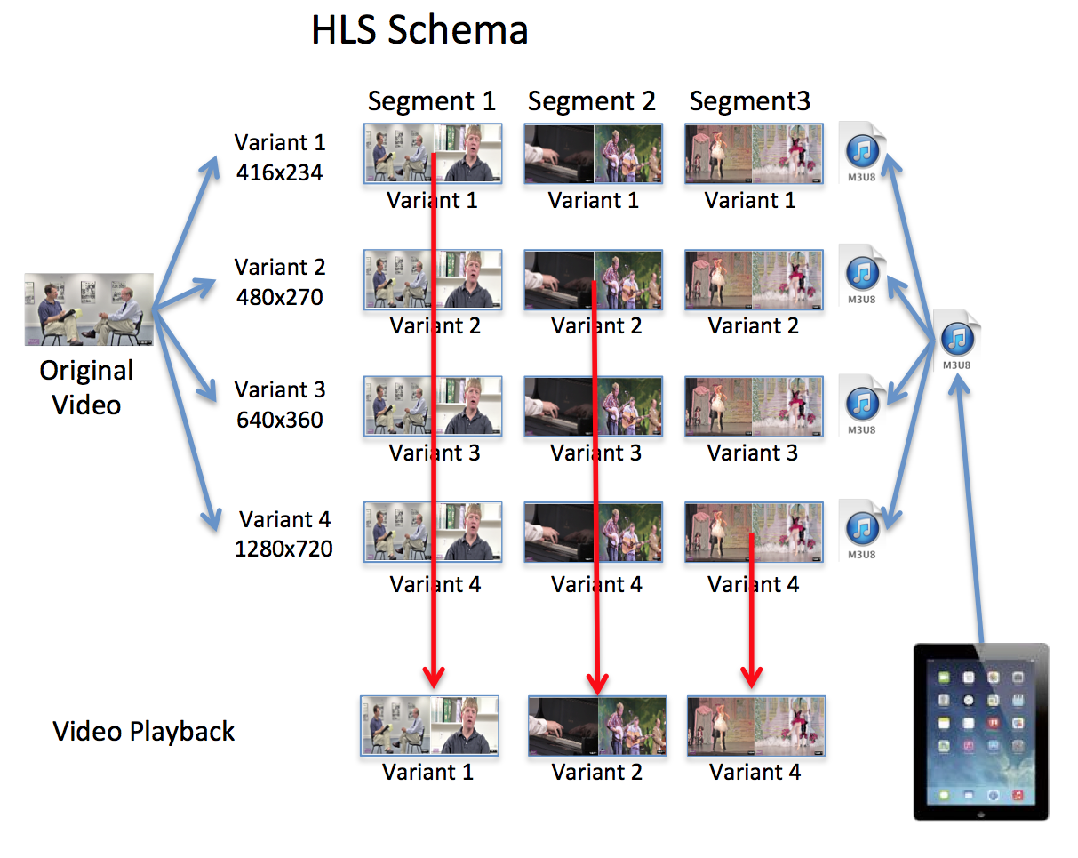

Slide 7
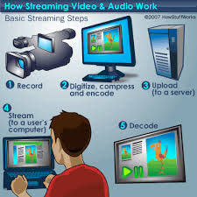

Slide 8
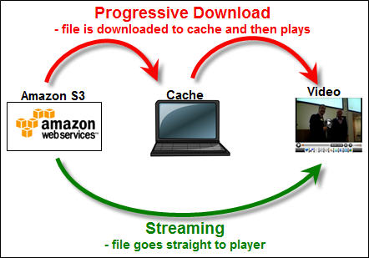

Slide 9
